Slide 1

Chapter 9: Project Human Resource Management
Information Technology Project Management, Sixth Edition
Note: See the text itself for full citations.

Slide 2
Announcements
10/27 - Chapter 7, then team breakouts
11/3 - Chapter 8, then team breakouts
11/10 - Chapter 9, then team breakouts
11/17 - Chapter 10 & 11
11/24 - No Class Happy Thanksgiving
12/1 - Chapter 12
12/8 - Final Demo presented; Final reports due
12/15 - Final Exam

Slide 3
Learning Objectives
Discuss human resource planning and be able to create a human resource plan, project organizational chart, responsibility assignment matrix, and resource histogram
Understand important issues involved in project staff acquisition and explain the concepts of resource assignments, resource loading, and resource leveling

Slide 4
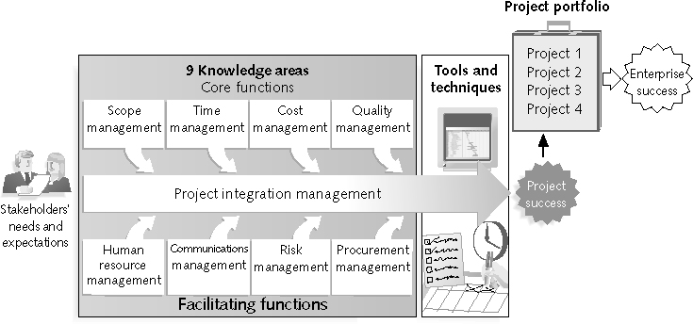
REVIEW: Project Management Framework – 9 Knowledge Areas

Slide 5
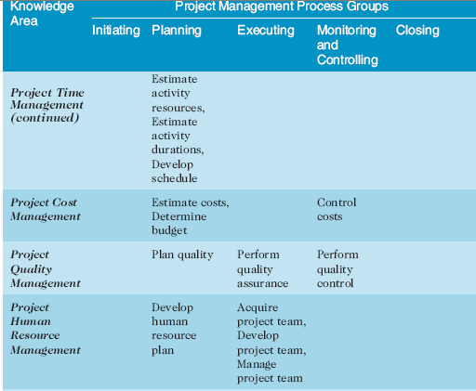
REVIEW:(continued)

Slide 6
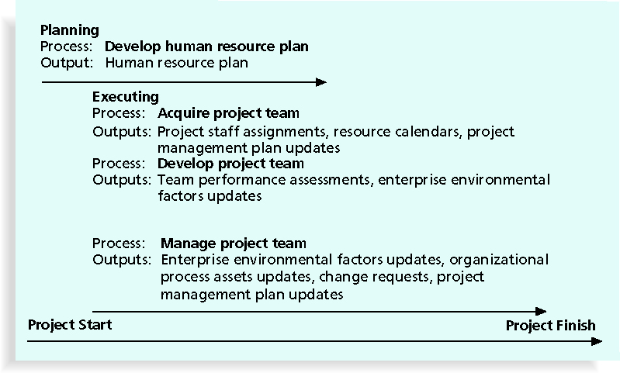
Figure 9-1. Project Human Resource Management Summary

Slide 7
What is Project Human Resource Management?
Making the most effective use of the people involved with a project
Processes include: Developing the human resource plan: identifying and documenting project roles, responsibilities, and reporting relationships
Acquiring the project team: getting the needed personnel assigned to and working on the project
Developing the project team: building individual and group skills to enhance project performance
Managing the project team: tracking team member performance, motivating teams, providing feedback, resolving issues and conflicts, coordinating changes that enhances project performance

Slide 8
The Importance of Human Resource Management
Many corporate executives have said, “People are our most important asset”
People determine the success and failure of organizations and projects

Slide 9
Implications for the Future of IT Human Resource Management
Proactive organizations are addressing workforce needs by:
Improving benefits
Redefining work hours and incentives
Finding future workers – pipelines
Growth & Development opportunities - training

Slide 10
Keys to Managing People
Psychologists and management theorists have devoted much research and thought to the field of managing people at work
Important areas related to project management include:
Motivation theories
Influence and power
Effectiveness

Slide 11
Intrinsic and Extrinsic Motivation
Intrinsic motivation causes people to participate in an activity for their own enjoyment
Extrinsic motivation causes people to do something for a reward or to avoid a penalty
For example, some children take piano lessons for intrinsic motivation (they enjoy it) while others take them for extrinsic motivation (to get a reward or avoid punishment)

Slide 12
Maslow’s Hierarchy of Needs
Abraham Maslow argued that humans possess unique qualities that enable them to make independent choices, thus giving them control of their destiny
Maslow developed a hierarchy of needs which states that people’s behaviors are guided or motivated by a sequence of needs

Slide 13
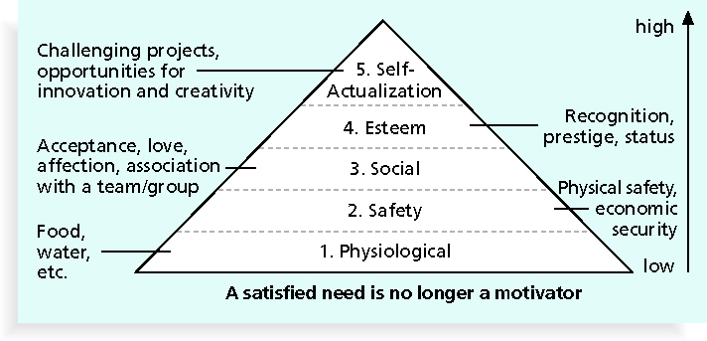
Figure 9-2. Maslow’s Hierarchy of Needs

Slide 14
Ways to Influence that Help and Hurt Projects
Projects are more likely to succeed when project managers influence with:
Expertise
Work challenge
Authenticity
Empathy
Projects are more likely to fail (over time) when project managers rely too heavily on:
Authority
Money
Penalty
One directional communication

Slide 15
Improving Effectiveness
Project managers can apply7 habits to improve effectiveness on projects
Be proactive
Begin with the end in mind – meaning goals
Put first things first – communicate the basics, foundation
Think win/win
Seek first to understand, then to be understood
Synergize
Sharpen the saw

Slide 16
Empathic Listening and Rapport
Good project managers are empathic listeners; they listen with the intent to understand
Before you can communicate with others, you have to have rapport, a relation of harmony, conformity, accord, or affinity
Mirroring is the matching of certain behaviors of the other person, a technique to help establish rapport
IT professionals need to develop empathic listening and other people skills to improve relationships with users and other stakeholders

Slide 17
Developing the Human Resource Plan
Involves identifying and documenting project roles, responsibilities, and reporting relationships
Contents include:
Project organizational charts
Staffing management plan
Responsibility assignment matrixes
Resource histograms

Slide 18
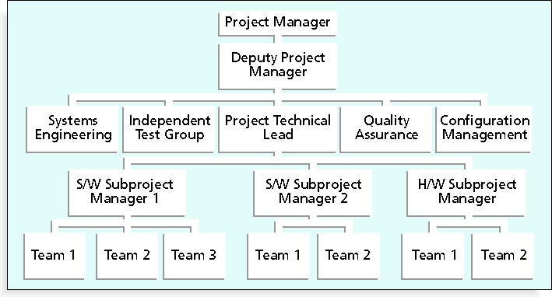
Figure 9-3. Sample Organizational Chart for a Large IT Project

Slide 19
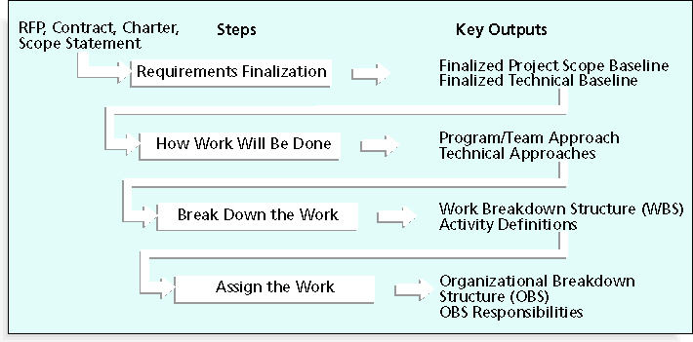
Figure 9-4. Work Definition and Assignment Process

Slide 20
Responsibility Assignment Matrices
A responsibility assignment matrix (RAM) is a matrix that maps the work of the project as described in the WBS to the people responsible for performing the work as described in the OBS
Can be created in different ways to meet unique project needs

Slide 21
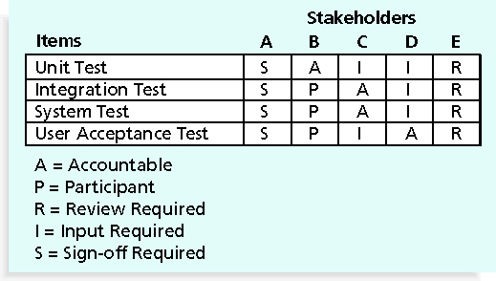
Figure 9-6. RAM Showing Stakeholder Roles

Slide 22
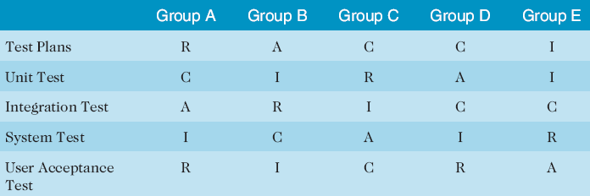
Table 9-2. Sample RACI Chart
R = responsibility
A = accountability, only one A per task
C = consultation
I = informed
Note that some people reverse the definitions of responsible and accountable.

Slide 23
Staffing Management Plans and Resource Histograms
A staffing management plan describes when and how people will be added to and taken off the project team
A resource histogram is a column chart that shows the number of resources assigned to a project over time

Slide 24
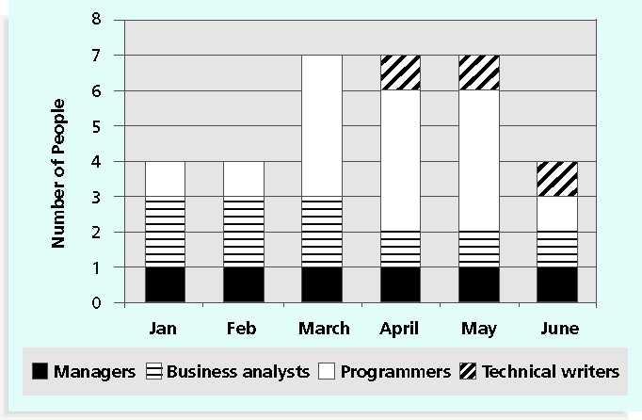
Figure 9-7. Sample Resource Histogram

Slide 25
Acquiring the Project Team
Acquiring qualified people for teams is crucial
It’s important to assign the appropriate type and number of people to work on projects at the appropriate times

Slide 26
Resource Loading
Resource loading refers to the amount of individual resources an existing schedule requires during specific time periods
Helps project managers develop a general understanding of the demands a project will make on the organization’s resources and individual people’s schedules
Overallocation: there is more work than the resource can handle at a given time

Slide 27
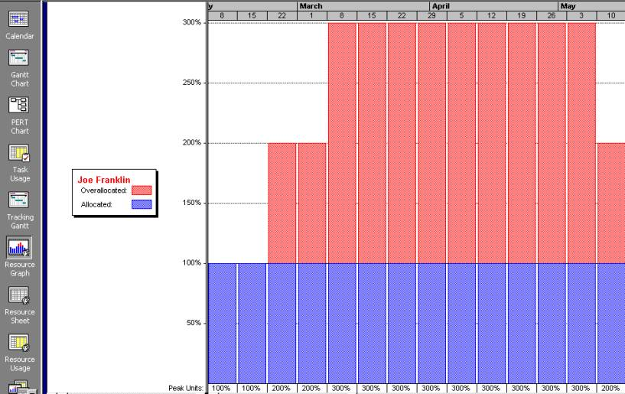
Figure 9-8. Sample Histogram Showing an Overallocated Individual

Slide 28
Resource Leveling
Resource leveling is a technique for resolving resource conflicts by moving tasks to when resources are available
The main purpose of resource leveling is to create a smoother distribution of resource usage and reduce overallocation

Slide 29
Developing the Project Team
The main goal of team development is to help people work together more effectively to improve project performance
It takes teamwork to successfully complete most projects

Slide 30
Tuckman Model of Team Development
Forming
Storming
Norming
Performing
Adjourning

Slide 31
Meyers-Briggs Type Indicator (MBTI)
MBTI is a popular tool for determining personality preferences and helping teammates understand each other
Four dimensions include:
Extrovert/Introvert (E/I)
Sensation/Intuition (S/N)
Thinking/Feeling (T/F)
Judgment/Perception (J/P)

Slide 32
Social Styles Profile
People are perceived as behaving primarily in one of four zones, based on their assertiveness and responsiveness:
Drivers
Expressives
Analyticals
Amiables
People on opposite corners (drivers and amiable, analytical and expressive) may have difficulties getting along

Slide 33
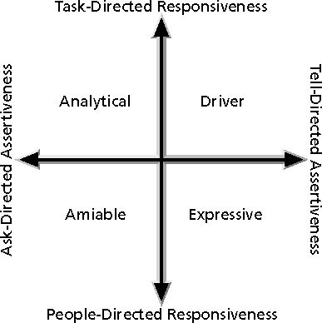
Figure 9-10. Social Styles

Slide 34
Reward and Recognition Systems
Team-based reward and recognition systems can promote teamwork
Focus on rewarding teams for achieving specific goals
Allow time for team members to mentor and help each other to meet project goals and develop human resources

Slide 35
Managing the Project Team
After assessing team performance and related information, the project manager must decide:
If changes should be requested to the project
If corrective or preventive actions should be recommended
If updates are needed to the project management plan or organizational process assets

Slide 36
Tools and Techniques for Managing Project Teams
Observation and conversation
Project performance appraisals
Conflict management
Issue logs
Interpersonal skills

Slide 37
General Advice on Teams
Be patient and kind with your team
Fix the problem instead of blaming people
Establish regular, effective meetings
Allow time for teams to go through the basic team-building stages (form, storm, norm….)
Limit the size of work teams to three to seven members – if possible, depends on project

Slide 38
General Advice on Teams (continued)
Plan some social activities to help project team members and other stakeholders get to know each other better
Stress team identity – goals, methods, philosophy
Nurture team members and encourage them to help each other
Take additional actions to work with virtual team members

Slide 39
Five Dysfunctions of a Team
Patrick Lencioni, author of several books on teams, says that “Teamwork remains the one sustainable competitive advantage that has been largely untapped”*
The five dysfunctions of teams are:
Absence of trust
Fear of conflict
Lack of commitment
Avoidance of accountability
Inattention to results
*Lencioni, Patrick, “Overcoming the Five Dysfunctions of a Team,” Jossey-Bass: San Francisco, CA (2005), p. 3.

Slide 40
Chapter Summary
Project human resource management includes the processes required to make the most effective use of the people involved with a project
Main processes include:
Develop human resource plan
Acquire project team
Develop project team
Manage project team

